Slide 1
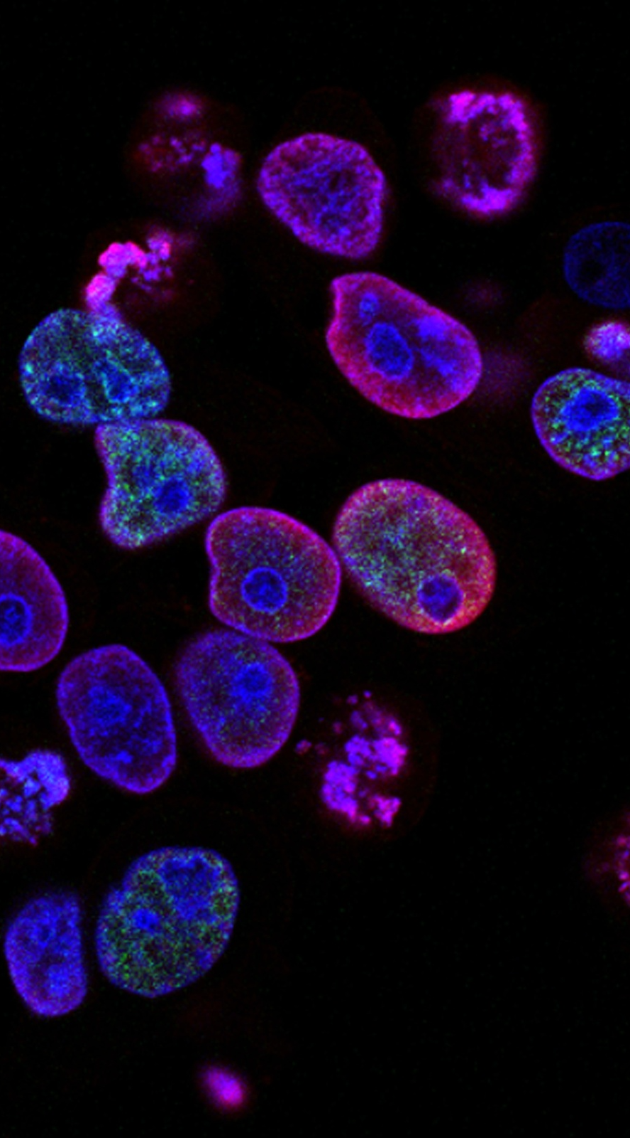
Malaria Detection
Presented by Paige Macmillan
Notes:
Good morning/afternoon, everyone. Thank you for joining me today.
We're here to discuss a transformative approach to a pressing global health issue: the rapid and accurate diagnosis of malaria

Slide 2
Significant global impact
Manual diagnosis has limitations
Machine learning enables rapid, accurate diagnosis
Nearly all cases occur in 29 countries, with highest burdens in Africa. Malaria cases and deaths increased from 2019 to 2020.
It's slow, accuracy depends on expertise, and quality issues lead to misdiagnosis.
Automated diagnosis with convolutional neural networks is up to to 98% accurate, enabling faster and more consistent results.
Problem Definition
Notes:
Malaria affects millions of people annually, with a substantial impact on healthcare systems and economies, particularly in developing nations, yet timely and accurate diagnosis remains a challenge, particularly in these resource-limited settings.
so the crux of the problem lies in diagnosis - Current diagnostic methods, while effective, have limitations such as the need for skilled personnel, time, and resources, which are often scarce where malaria is endemic.
A specialized technology proves essential to combat this problem, and this is where our AI-driven solution steps in!

Slide 3











Automated Diagnosis
Deep Learning: Convolutional Neural Networks (CNNs)
Specialized in Image Processing
Automated Feature Extraction
CNNs excel at processing visual data like images, making them ideal for detecting malaria in blood smears
CNNs automatically learn hierarchical image features, detecting low-level and complex patterns like parasitized cells
CNNs
Efficiency and Effectiveness
Handling Variability
CNNs require fewer parameters than ANNs, with convolutional and pooling layers reducing computations
CNNs have the ability to recognize patterns with extreme variability, such as different stages of malaria in blood cells, which is a challenge for ANNs
In summary, CNNs are well-suited for malaria detection from blood cell images due to their specialization in image processing, automated feature extraction capabilities, and efficiency.
Notes:
Automated diagnosis with convolutional neural networks is up to to 98% accurate, enabling faster and more consistent results.
CNNs are a perfect tool to automate diagnosis due to their unparalleled ability to process and analyze images. Unlike traditional neural networks, CNNs can automatically learn complex patterns and features within blood cell images.
CNNs require fewer parameters than ANNs and are therefore computationally more efficient than ANNs. Additionally, CNNs have the ability to recognize patterns with extreme variability, such as different stages of malaria in blood cells, which is a challenge for ANNs.

Slide 4



Deep Learning to Solve the Problem
Improve diagnostic speed and accuracy
Enhance accessibility
Support early treatment
Deploy the AI system on basic hardware to enable malaria testing in remote areas
Faster diagnosis through AI system allows prompt treatment to save lives
Use AI and deep learning to automate malaria detection from blood smears with 98%+ accuracy
AI-powered automated malaria detection improves accuracy, accessibility and enables earlier treatment
Notes:
Our goal is ambitious yet vital: to revolutionize malaria diagnosis. This means making it faster, more reliable, and widely accessible.
Our research shows that it is possible to achieve these objectives using AI through CNNs to automate the detection process
The solution we are proposing today achieves diagnosis with an astounding 98% accuracy, all while scaling the screening process, expanding access in remote and resource-constrained regions, and allowing for more widespread and rapid identification of malaria cases

Slide 5




Solution Approach
Image preprocessing
Data normalization
Experimenting with Additional Preprocessing Steps
Model selection based on accuracy and recall
Resized to fixed width/height because a CNN cannot train images of different sizes
This ensures that each intensity is converted to the same scale, and can be compared accurately.
Chose model with highest accuracy and recall for parasitized class to minimize false negatives
Converting the images to HSV images or applying Gaussian Blurring on train and test data
Especially important in high stakes domains, such as healthcare
Experimenting with data augmentation
Careful data preprocessing and model selection focused on accuracy and recall resulted in a suitable model for malaria detection
Notes:
Our approach in building an effective solution involved meticulous and robust data preprocessing to ensure consistency and reliability.
this included resizing the test and train images, and normalizing the data to stabilize the training process
Implementing stain normalization enhances the generalizability and robustness of computer-assisted diagnostic tools
Throughout our research, we compiled and trained several variations of CNN-based models on the NIH Malaria Dataset.
we toggled with different hyperparameters, regularization techniques, activation functions, and preprocessing steps
We analyzed the model outcomes focusing on key performance metrics, particularly aiming to maximize accuracy and recall (or minimizing false negatives).
these performance criteria are particularly important in high stakes domains such as this, where misclassifications can have serious consequences. More specifically, the consequences of a false negative malaria test may lead to death that could otherwise have been avoided with accurate early diagnosis

Slide 6
Key Findings
Superior performance of CNNs
High accuracy and recall rates
Effective identification of parasitic cells
The CNN models showed high accuracy of in identifying parasitized cells, demonstrating their superior performance for this task
Our findings revealed that CNNs significantly outperform traditional methods in image-based diagnosis, achieving remarkable accuracy and recall rates in identifying malaria-infected cells
The models accurately identified visual signs of parasitemia like inclusions and irregular shapes, showing effectiveness for malaria diagnosis
The CNN models developed demonstrate high accuracy, recall and effectiveness in identifying malaria infected cells, showing strong potential as an automated parasitemia detection solution.
Notes:
Our findings have been groundbreaking. CNNs have demonstrated exceptional performance in analyzing blood cell images, achieving accuracy and recall rates that far surpass traditional diagnostic methods.
The models accurately identified visual signs of parasites like inclusions and irregular shapes, showing effectiveness for malaria diagnosis.
This is a game-changer in identifying malaria-infected cells

Slide 7

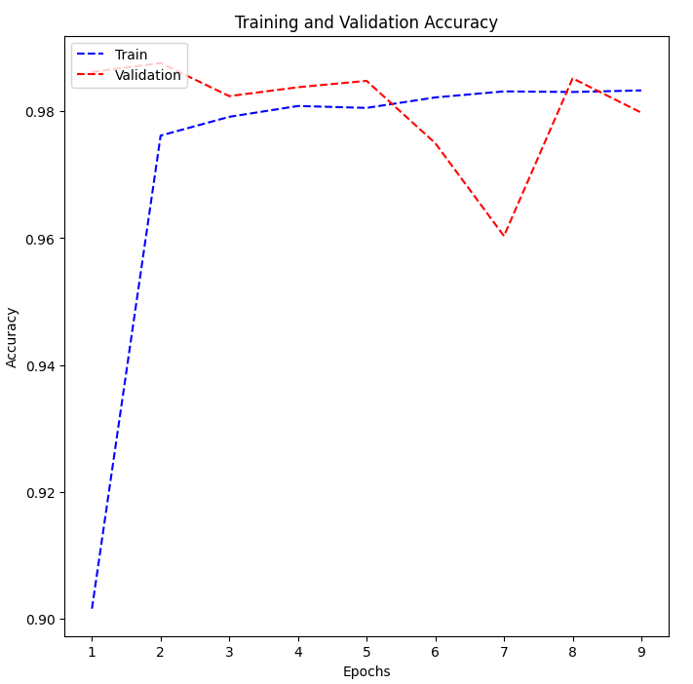


The Solution – The Base Model
Balanced complexity and performance
Achieves high accuracy with only 2 million parameters, keeping the model relatively simple
High accuracy with fewer parameters
Maintains 98% test accuracy while using fewer parameters, making it efficient
Suitable for low-resource environments
Less computationally intensive due to fewer parameters, viable where computing resources are limited
The Base Model provides a balanced and optimized solution for malaria detection, with high performance, efficiency, and suitability for low-resource settings.
Notes:
The Base Model stands as our final solution.
Its architecture is streamlined, featuring convolutional layers that capture the nuances of infected cells, dropout layers to prevent overfitting, and dense layers for classification."
"It operates with remarkable accuracy and a low false-positive rate, which is critical for ensuring proper treatment."
It's a balance of sophistication and efficiency, designed to identify malaria with over 98% accuracy. It has the highest recall rate in comparison to the other models at 98% - only 23 out of 1300 parasitized cells were misclassified as ‘uninfected’.
Its architecture, while complex enough to ensure accuracy, remains computationally viable for widespread use in low-resource environments, which are typically characteristic of ‘malaria areas’
This graph represents the model's performance across thousands of test images, clearly demonstrating its diagnostic capabilities

Slide 8
Proposed Business Solution
Adopt AI diagnostic tool
Reduce costs
Replace traditional microscopy methods with automated CNN model
Lower labor and hospitalization costs through automation
Improve patient throughput
Enhance patient outcomes
Faster diagnosis and treatment with reduced wait times
Earlier detection enables timely treatment interventions
Proposed AI solution aims to reduce costs, improve throughput, and enhance outcomes through automation.
Notes:
This is what adopting the AI diagnostic tool would mean from a business standpoint:
To implement this solution, I recommend establishing pilot programs in high-risk areas, which will facilitate real-world testing and adaptation.“
the integration into existing digital health platforms can streamline workflows and support healthcare workers on the ground.“
Adopting this model could lead to significant cost savings in diagnostic procedures, a reduced burden on healthcare workers, and potentially, lives saved through timely treatment."
It represents a sustainable, scalable tool in the fight against malaria, with potential applications in other diseases."

Slide 9
Executing the Business Solution
Infrastructure Investment
Invest in high-performance computing systems, storage, software, networking to support AI model deployment
Training for healthcare staff
Train doctors, nurses, technicians on proper use of AI tool for accurate diagnoses and efficiency
Integration into healthcare systems
Integrate AI model into existing IT systems after obtaining necessary regulatory approvals
Develop pipeline for data collection and model updating
Build systems to regularly collect new patient data to retrain AI model and adapt to changes
Secure regulatory approvals for clinical AI use
Obtain certifications from regulatory bodies to ensure safety, efficacy and legitimize clinical use
Notes:
"To bring this solution to fruition, we need a concerted effort in five key areas: infrastructure, training, integration, data collaboration, and navigating regulatory pathways.
This means not only investing in the necessary hardware and software but also ensuring that your healthcare staff are equipped with the necessary training to achieve proficiency in using this new tool.
we will need to integrate this model into our existing healthcare systems, ensuring compatibility with our IT infrastructure and adherence to all regulatory requirements for clinical AI use
By contributing to our data collection efforts, you help us continuously improve the tool, ensuring it stays at the forefront of diagnostic excellence.
We'll work together to secure all necessary regulatory approvals, ensuring compliance and patient safety."

Slide 10


Cost-Benefit Analysis - Malaria Detection
Estimated Costs
Estimated Benefits
$500,000 (development)
$547,500 (efficiency savings)
$75,000 (annual maintenance)
$200,000 (hospital stay reductions)
$50,000 (annual training)
$60,000 (annual labor savings)
Total $1,250,000 Over 10 Years
Total $8,075,000 Over 10 Years
Estimated Profit Over 10 Years = $6,825,000
*Data sourced from provided document
Notes:
Although execution of the business plan involves several costs, the monetary benefits of diagnostic automation appear to surpass these costs substantially.
with the following cost assumptions, we expect the solution to generate almost $7 million in profits over 10 years.

Slide 11
Business Risks and Challenges
Accuracy and reliability risks
Incorrect diagnoses could lead to health risks and liability
Data security risks
Potential data breaches compromising privacy
Data challenges
Bias and lack of diverse data can limit robustness
Slow adoption
Resistance from professionals due to lack of trust
Integration difficulties
May not integrate well with existing systems, causing disruptions
Notes:
"While the path ahead is promising, it's not without challenges.
We must navigate data security concerns, ensure the model's adaptability to new data, and consider the tool's reliability across diverse settings, and devise ways to combat resistance of adoption by healthcare professionals due to trust issues.
These challenges, though significant, are surmountable with careful planning and collaboration and must be weighed against the substantial benefits of implementing the solution

Slide 12
Executive Summary
Automated diagnosis
Expanded testing
CNN model for fast and accurate malaria detection from blood samples
Scalable AI solution enables widespread screening
Prompt treatment
Cost savings
Faster diagnosis reduces treatment delays, saving lives
More efficient use of healthcare resources
Revolutionizing malaria diagnosis with AI to reduce disease burden and enable a healthier future.
Notes:
"In conclusion, our AI-based solution for malaria diagnosis is set to revolutionize the field. It brings unparalleled accuracy, speed, and accessibility to a process that has long been constrained by traditional methods. This is more than an innovation; it's a step towards a healthier future for millions impacted by malaria.“
"I urge you to consider its potential and the tangible difference it could make in global health outcomes."

Slide 13
Thank You.
Notes:
"I'm now open to any questions you may have and am eager to discuss how we can tailor this solution to meet your specific needs."

